Slide 1
Lead dust from Magellan Metals Mine
Group 3
Presented by:
J040 Atharva Kaushik
J045 Advait Menon
J049 Shubhangi Ojha
Australia, 2006
Date Presented:
August 10th 2022

Slide 2
Roadmap
Introduction and outline of the case study
Why is Lead required
Evils of Lead Mining
Lead Mining in Magellan Metals
The case study
Australian Government’s steps to mitigate the lead poisoning
Aftermath
Learning
References

Slide 3
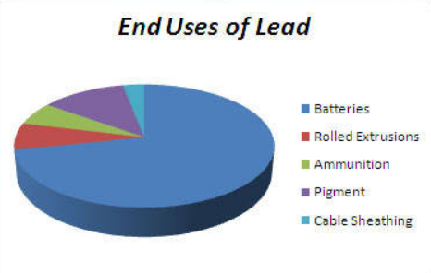
Why is lead needed ?
Lead Acid Battery
Rolled Extrusions
Lead Pipes
Pigments in paints
Cable Sheathing
Ammunition

Slide 4
Why is Lead so infamously destructive?
Dangerous to all forms of living beings in the environment, humans and other fauna, alike.
Causes lifelong issues like hypertension in dogs, hearing loss in monkeys, aggressive tendencies in cats, etc.
Animals aren’t aware of the presence of lead in the food they ingest and the water they consume, so increase in toxin levels in the bloodstream is a direct consequence.

Slide 5
Why is Lead so infamously destructive?
Exposure to high levels of lead may cause anemia, weakness, and kidney and brain damage. Very high lead exposure can even lead to death .
Lead exposure can also affect the unborn children more than pregnant women .
It can damage the child's nervous system , lead affects children more than adults in general .

Slide 6
Brief outline of the case study
Magellan Metal Mines- Australia, used to be involved in lead mining activities.
Between 2006 and 2007, it was discovered that the lead dust that used to escape into the air during transportation, used to impact the port town of Esperance.
This was a literal example of “Canaries in the mine”.

Slide 7
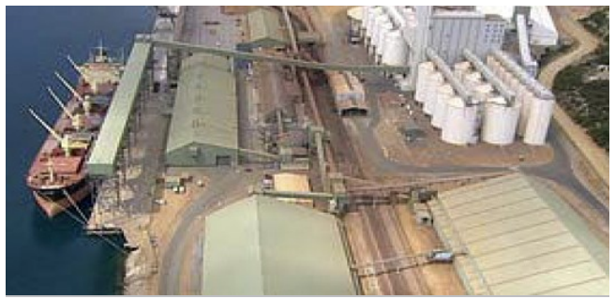
About
Lead Mining in Magellan Metals
Magellan metals was capable of providing 2% of the world’s lead supply if operated at full capacity.
Until March 2007, the lead carbonate concentrate produced at the mine was exported in bulk through the Port of Esperance, transported in tarpaulin-covered kibbles by trucks and trains.
At the port it was stockpiled inside a large storage shed and loaded onto ships by a series of conveyors
Port of Esperance

Slide 8
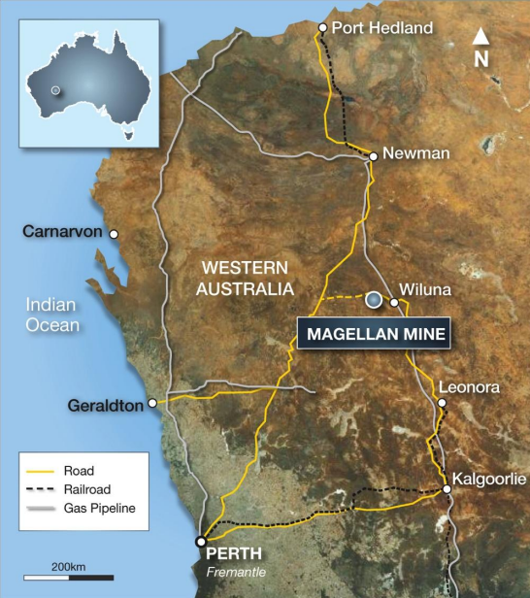

Slide 9
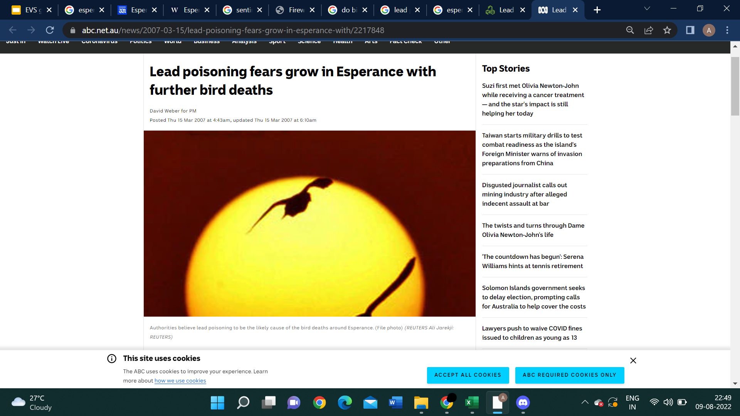
The
Case Study

Slide 10
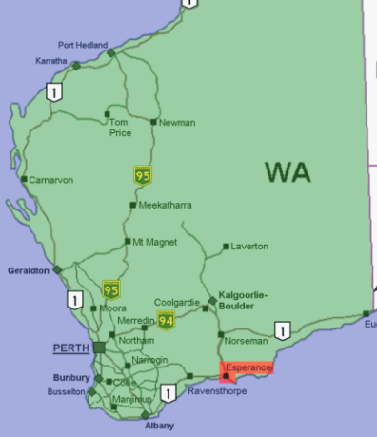
So…
Where did it all go wrong?
In late 2006, the community of about 14,000 people in the town of Esperance in Western Australia was alerted to several native bird species dying. It was reported that the number of dead birds exceeded 9,000.
Early investigations by the Western Australia Department of Agriculture and Food discounted such causes as bird flu and pesticides, and eventually they discovered that the birds were dying from lead poisoning.

Slide 11
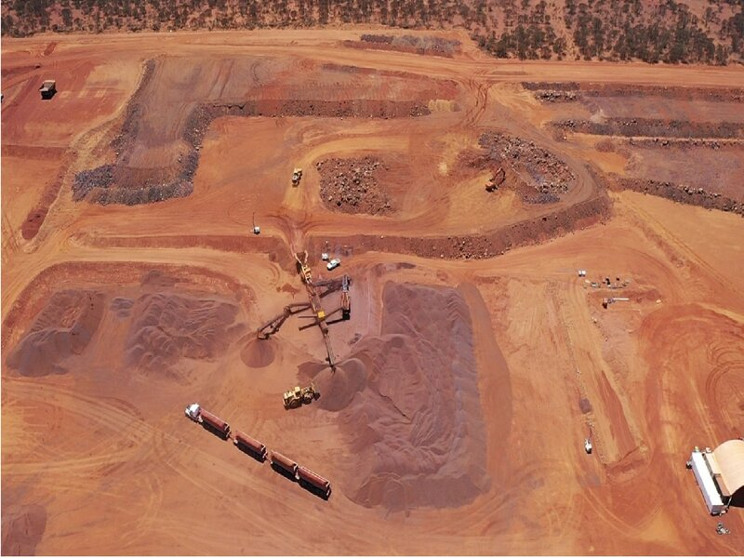
A deposit of cerussite was mined by Magellan Metals near Wiluna, 900 km north of Esperance.
The resulting lead carbonate concentrate was transported as a bulk commodity by road and rail prior to being exported through the Port of Esperance between July 2005 and March 2007.
Lead as a fine dust escaped during the transport, storage and loading processes at the Port, leading to widespread contamination across the town.
Wiluna mines

Slide 12
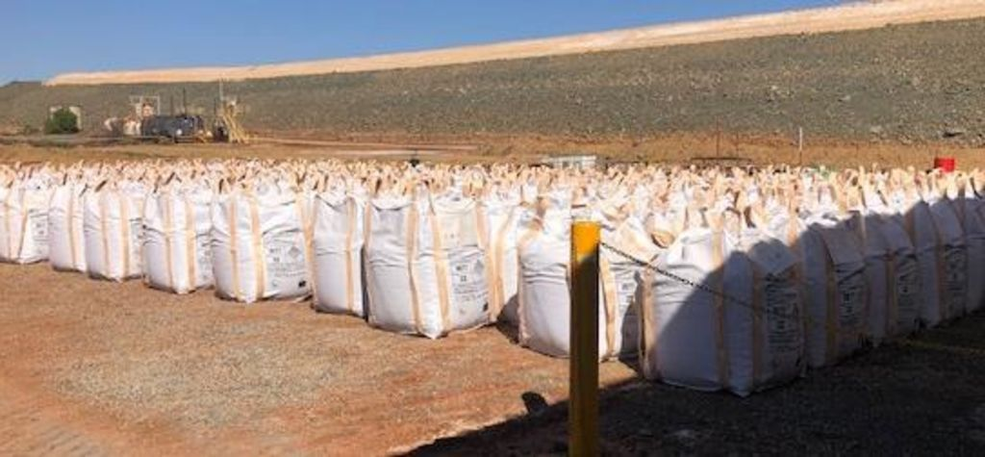
The Pb concentrate being shipped through the port was lead carbonate, which is a relatively unusual mining product; the most common lead ore is galena [lead sulfide (PbS)].
Subsequently it was found that inadequate infrastructure and the mishandling of the lead carbonate concentrate during bulk loading onto ships in hot, dry and windy conditions had allowed lead dust to escape, which had an impact on the town of Esperance and its surroundings.
Lead stored at the mines

Slide 13
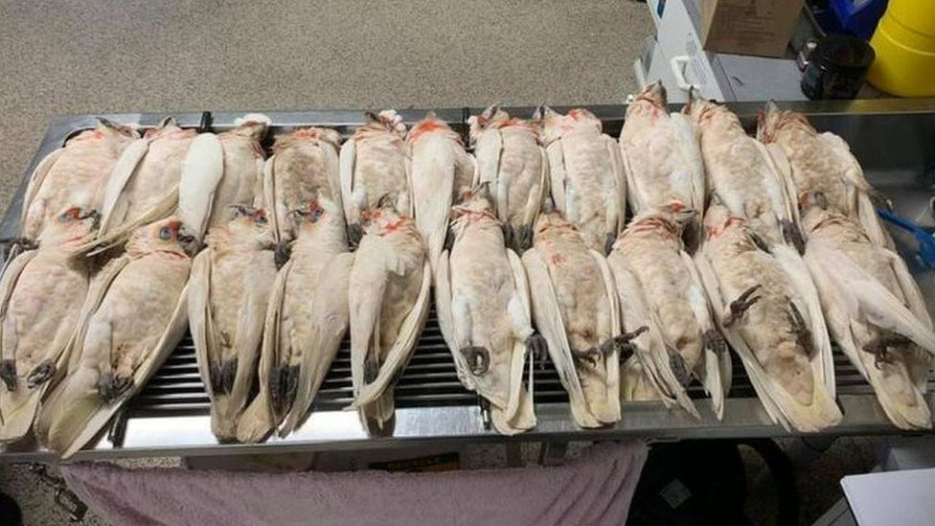
The bird population was most probably affected by the presence of lead because of the nectar they consumed, water they drank and while preening off the lead dust from their bodies.
The avian species being affected was the best example of how different living elements in the environment act as a sentinel species.

Slide 14
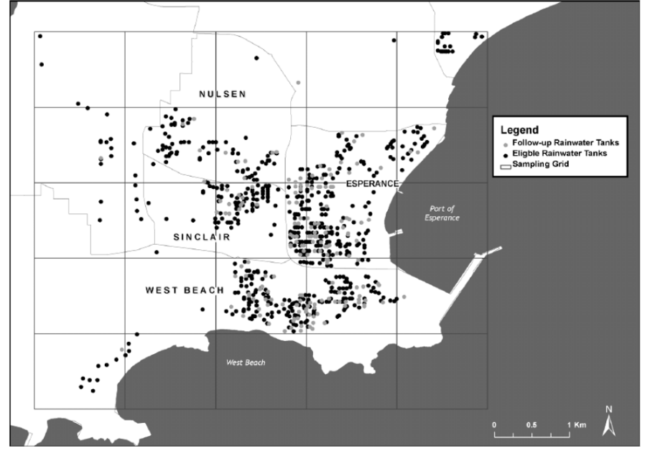
After the sightings of birds dropping dead from the sky, autopsied birds showed the presence of lead in their kidneys, livers and brains.
The observations pushed the government to investigate further, and they found nickel and lead content in nearly 19-24% of the water tanks.
Australian officials also discovered that lead dust from the ore had contaminated drinking water, soil, harbor sediments, shellfish, and house dust, and found elevated blood lead levels in people, including young children.
It did not end there…

Slide 15

Blood lead testing:
Particular emphasis was placed on identifying those individuals, particularly young children (especially those aged 5 years and under) who have been affected by lead emissions.
Soil and surface testing:
The highest lead reading recorded - 380 mg/kg, from bare soil beside the quarantine station next to the Port.
standard trigger levels for such sites is 1500 mg/kg.
For residential areas - 300 mg/kg.
The highest recorded at these sites was 88 mg/kg and the majority were less than 10 mg/kg
Government's approach

Slide 16
Health and ecological risk assessment:
In August 2007, DEC appointed independent consultants to carry out a health and ecological risk assessment of the impacts of the emissions from Esperance Port Authority operations on the Town of Esperance.
Environment protection measures:
The first EPN was issued on 9 October 2007, requiring further cleaning of Port facilities to remove lead carbonate residues
The second EPN was issued on 25 October, requiring the Port Authority to provide fully interpreted air quality monitoring data collected since February 2007 and to prepare a comprehensive air quality monitoring program for future operations

Slide 17

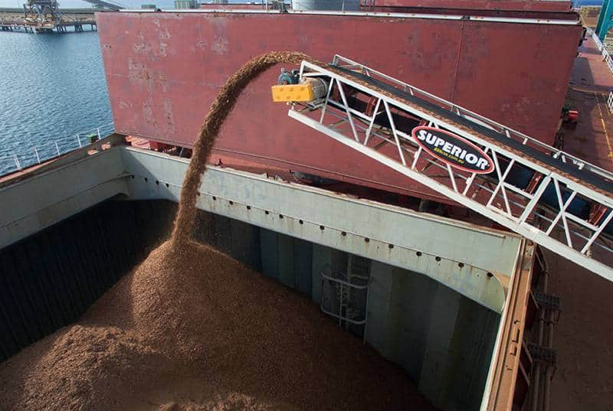
The Aftermath
On 12 March 2007, the board of the Esperance Port Authority put an immediate stop to any further shipments of lead carbonate through the port.
The DEC subsequently instigated legal action against the Esperance Port Authority on various matters relating to polluting the Esperance town site. The Port entered a guilty plea on most charges in October 2009 and was subsequently fined A$525,000 under the WA Environmental Protection Act 1986.

Slide 18
Learnings
Reverse Osmosis needs to be performed before drinking potentially contaminated water.
Proper packaging of the lead shipments before transporting it to the port.
Decontamination of the trucks/trains before leaving the mining site.
Being precautious with lead carbonate bags while loading them onto the ships.
Holding the involved authorities accountable for their misconduct.
Introducing strict measures for employees working in the mines.

Slide 19
THANK YOU
https://www.australianmining.com.au/features/when-things-go-wrong-a-lesson-in-lead-mining/
https://www.ncbi.nlm.nih.gov/pmc/articles/PMC2627859/
https://thestringer.com.au/esperance-wa-sacrifice-zone-for-the-profits-of-the-uranium-industry-10583#.YujNpnZBxPY
http://s21.q4cdn.com/981952641/files/doc_presentations/2012/4152012-1_v001_x6f475.pdf
https://www.business-humanrights.org/en/latest-news/birds-fell-out-of-the-sky-as-a-whole-town-was-poisoned-by-lead-dust-australia/
J040 ATHARVA KAUSHIK
J045 ADVAIT MENON
J049 SHUBHANGI OJHA

